Slide 1
NFL
ANALYTICS
What the NFL “Geek Groups” Look Like ...
Analysis based on NFL analytics data published by SETH WALDER of ESPN Analytics in 2021, 2022 and 2023
Data analytics performed using Excel & Tableau by Ken Barlow (Indianapolis) – https://tinyurl.com/KB-ResumePage
For best experience, view PPT

Slide 2
CREDITS:
Seth Walder – ESPN Analytics
Visit the ESPN Analytics home page at:
www.espn.com/analytics
Data taken from articles from 2021, 2022 and 2023.

Slide 3
CONTENTS
1
What Teams are the Most Analytical?
2
What are the Various Data Analytical Roles?
3
(in progress)
4
(in progress)
5
(in progress)

Slide 4
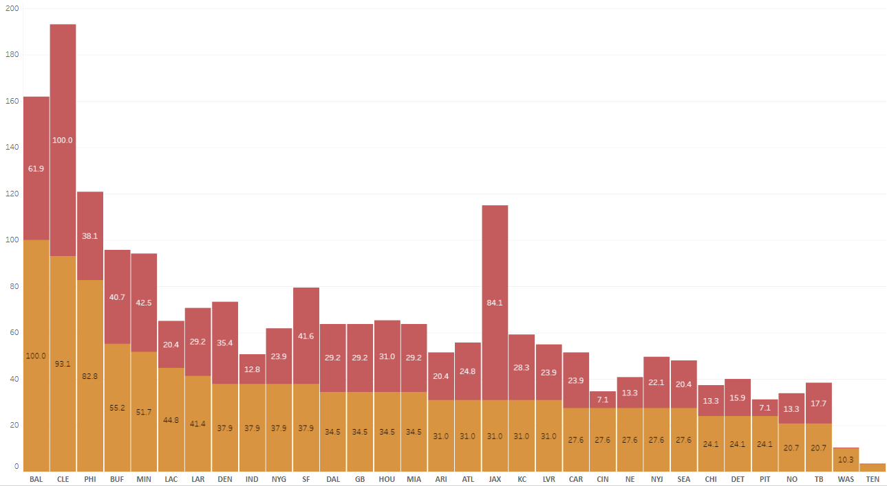
PEER RATINGS & INVESTMENTS IN DATA TEAMS
1
WHAT TEAM IS THE MOST ANALYTICAL?
7
Relative “Most Analytically Inclined” rating from Walder’s NFL Analytics Survey 2022
Relative Salary Expenses (estimated!) based on Job Titles from Walder’s 2021 NFL Analytics Survey
# Staff per 2021 NFL Analytics Survey
Baltimore was rated top of the class by other NFL teams and likely spent less than runner-up Cleveland because they had fewer executives (i.e. VP levels).
6
Jacksonville (likely) spent the 2nd most but had
only a moderate rating from other teams, receiving only 1 vote as one of the Top 5 “most analytical teams”.
4
7
4
4
3
3
3
1
2
3
3
3
3
2
estimated salary spending
2
3
2
2
3
3
2
1
1
2
1
1
2
1
most analytically inclined to least
0
0

Slide 5
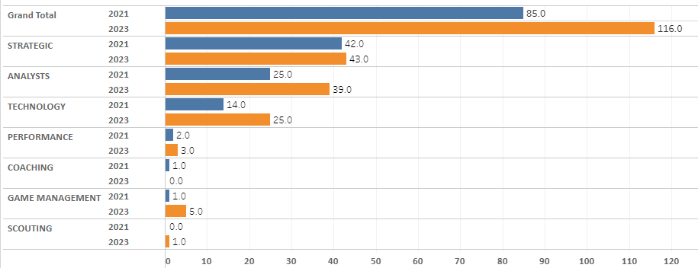
WHAT ROLES ARE PLAYED ON NFL ANALYTICS TEAMS?
2
NFL DATA ANALYTICS JOB TITLES GROWTH BY YEAR
JOB TITLES by CATEGORY by YEAR
36% increase in NFL Data Analytics jobs from 2021 to 2023
Technology Jobs Almost Double
Game Management Also Increasing
Generalized data from Walder’s 2021 and 2023 NFL Data list of Data Analytics Survey by reviewing job titles
“Strategic” – Typically Directors or Managers of Analytics
“Analysts” – Typically had analysts in the job title
“Technology” – Needed either “Data Scientist”, “Developer”, “Quantitative” or “Database” in job title

Slide 6
AI TRANSLATION interactive call sheets …? wow!
VISIT MY RESUME PAGE:
https://tinyurl.com/KB-ResumePage

